Slide 1

Welcome to H.O.T. www.handsontech.org
Our Purpose:
Forum for interaction
Many hobbyists build/tinker in isolation
Make new friends with common tech interests
Learn together
Lots of fun new tech to explore
Share expertise, help each other
Build something
Hands-On learning
Make something fun & useful

Slide 2



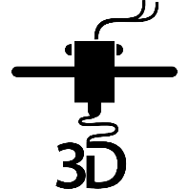

One Hands-On Tech club Two Groups
3D Printing
Small Computers

Slide 3
New to the club? Welcome!
Wondering what H.O.T. is all about?
This is a hands-on group, so we may be in the middle of a series of meetings on our way to building something interesting
Go to handsontech.org>New Members for a specially designed launching point for new members!
Please take the time to look through a few presentations at hhandsontech.org>Small Computers or handsontech.org>3D Printing.
Presentations are always available online after our meetings for reference and as self-paced projects
Notes:
3

Slide 4
Club communications are via Email & Web !
To join our email list(s), fill membership form at handsontech.org>New Members
When asked for your email address, use a gmail email address if possible (we use google forums & they are picky)
You will be added automatically to our Hands-On Tech (H.O.T.) overall email list
You will also be added to the Small Computers and/or 3D Printing mailing lists and forums if you expressed interest in the membership form.
Meeting calendar is at handsontech.org
Notes:
4

Slide 5
Small Computers and Robots
Small Computers have become powerful enough to be capable of running ROS (The Robot Operating System).
Today, we will explore ROS, but first let’s get some background in robots.
Notes:
5

Slide 6
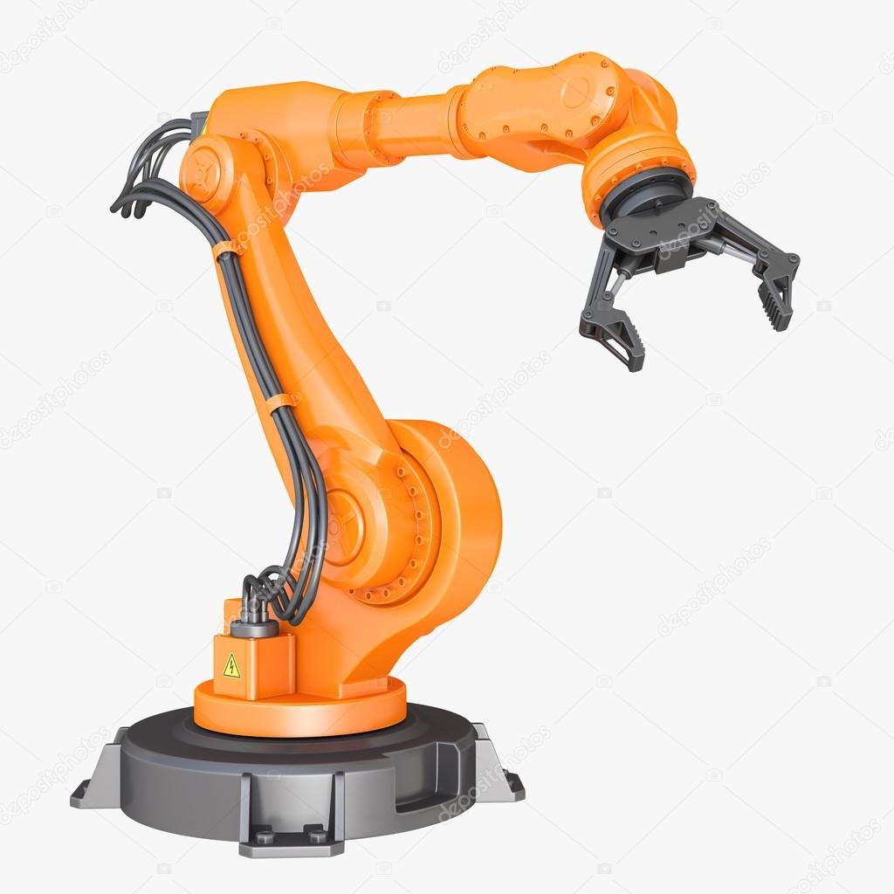
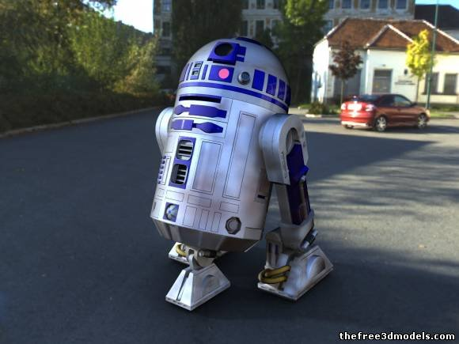
Different types of Robots
Mobile Robots
Industrial Robots
Robots with Articulated Joints
Notes:
6

Slide 7
Common Mobility Configurations
Ackerman (like a car)
Differential drive (like a zero-turn mower)
2 independent DOF: X and Theta-Z
Holonomic
3 independent DOF: X, Y, Theta-Z
Other (Skid steer, Tank)
Notes:
7

Slide 8
Control Capabilities
Tele-Op (Remote control)
Line Following
Video:
https://user-images.githubusercontent.com/53412304/149933346-67529f40-a361-49d7-a500-9bff151f2244.mp4
Notes:
8

Slide 9
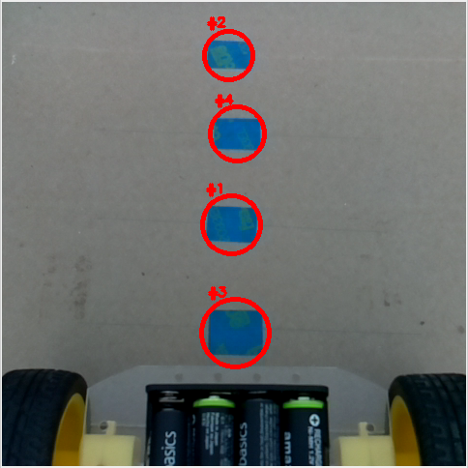
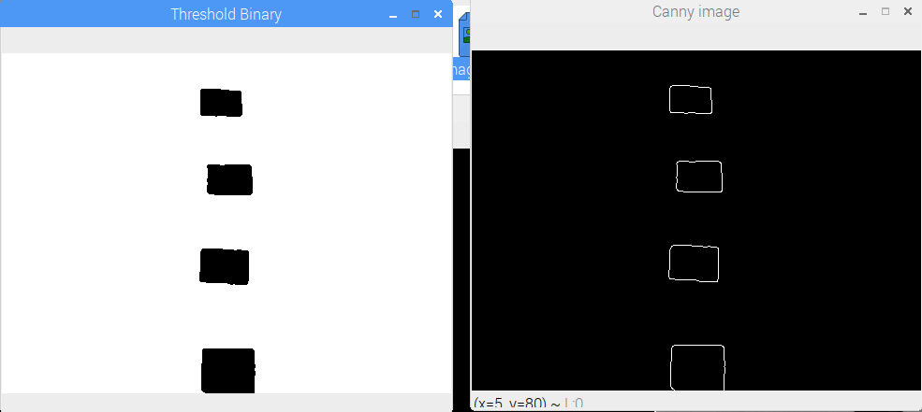
Image processing
Notes:
9

Slide 10
Control Capabilities
Tele-Op (Remote control)
Line Following
Obstacle Avoiding
Mowing the Lawn
ex: Early robotic vacuum cleaner
Autonomous Navigation
ex: Newer robot vacuum cleaner
Video:
https://user-images.githubusercontent.com/53412304/149934072-482f5c16-fb76-40cb-901d-27de9d9e856b.mp4
Notes:
10

Slide 11
Autonomous navigation Getting from point A to Point B
The robot needs to know where it is:
A Map would be nice
It needs to discover where it is on the map
Cameras?
Odometer?
Lidar?
In order to drive to a goal position
Path Planning
Detect and avoid obstacles
Notes:
11

Slide 12
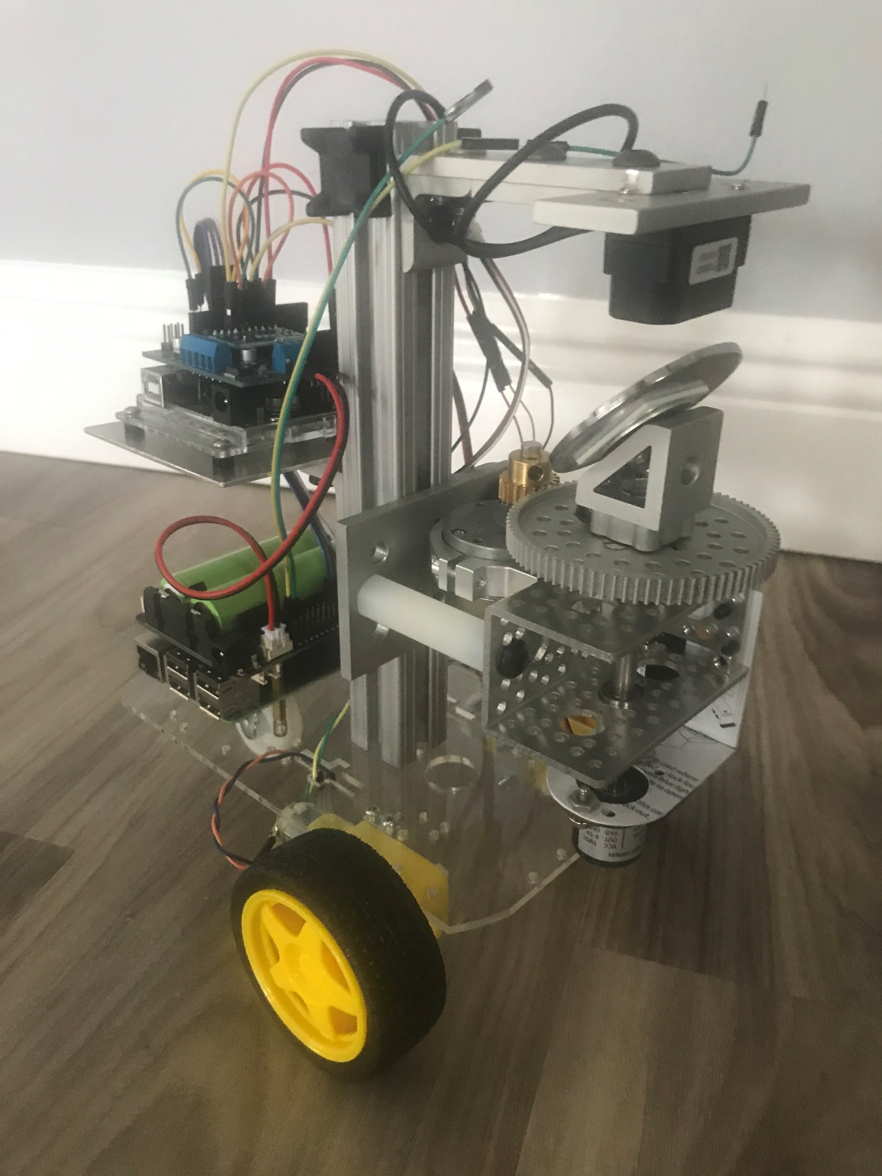
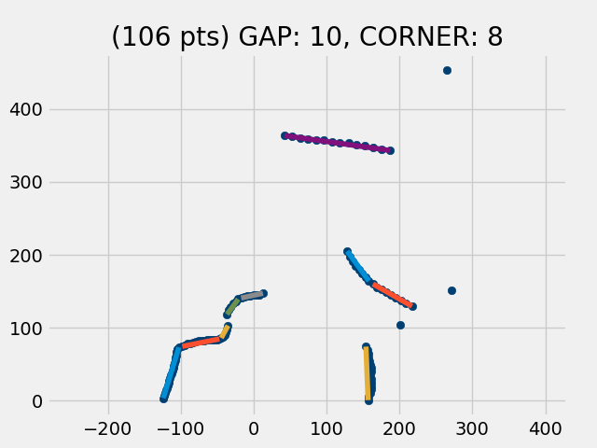
Diff drive Robot with LiDAR & IMU
Notes:
12

Slide 13
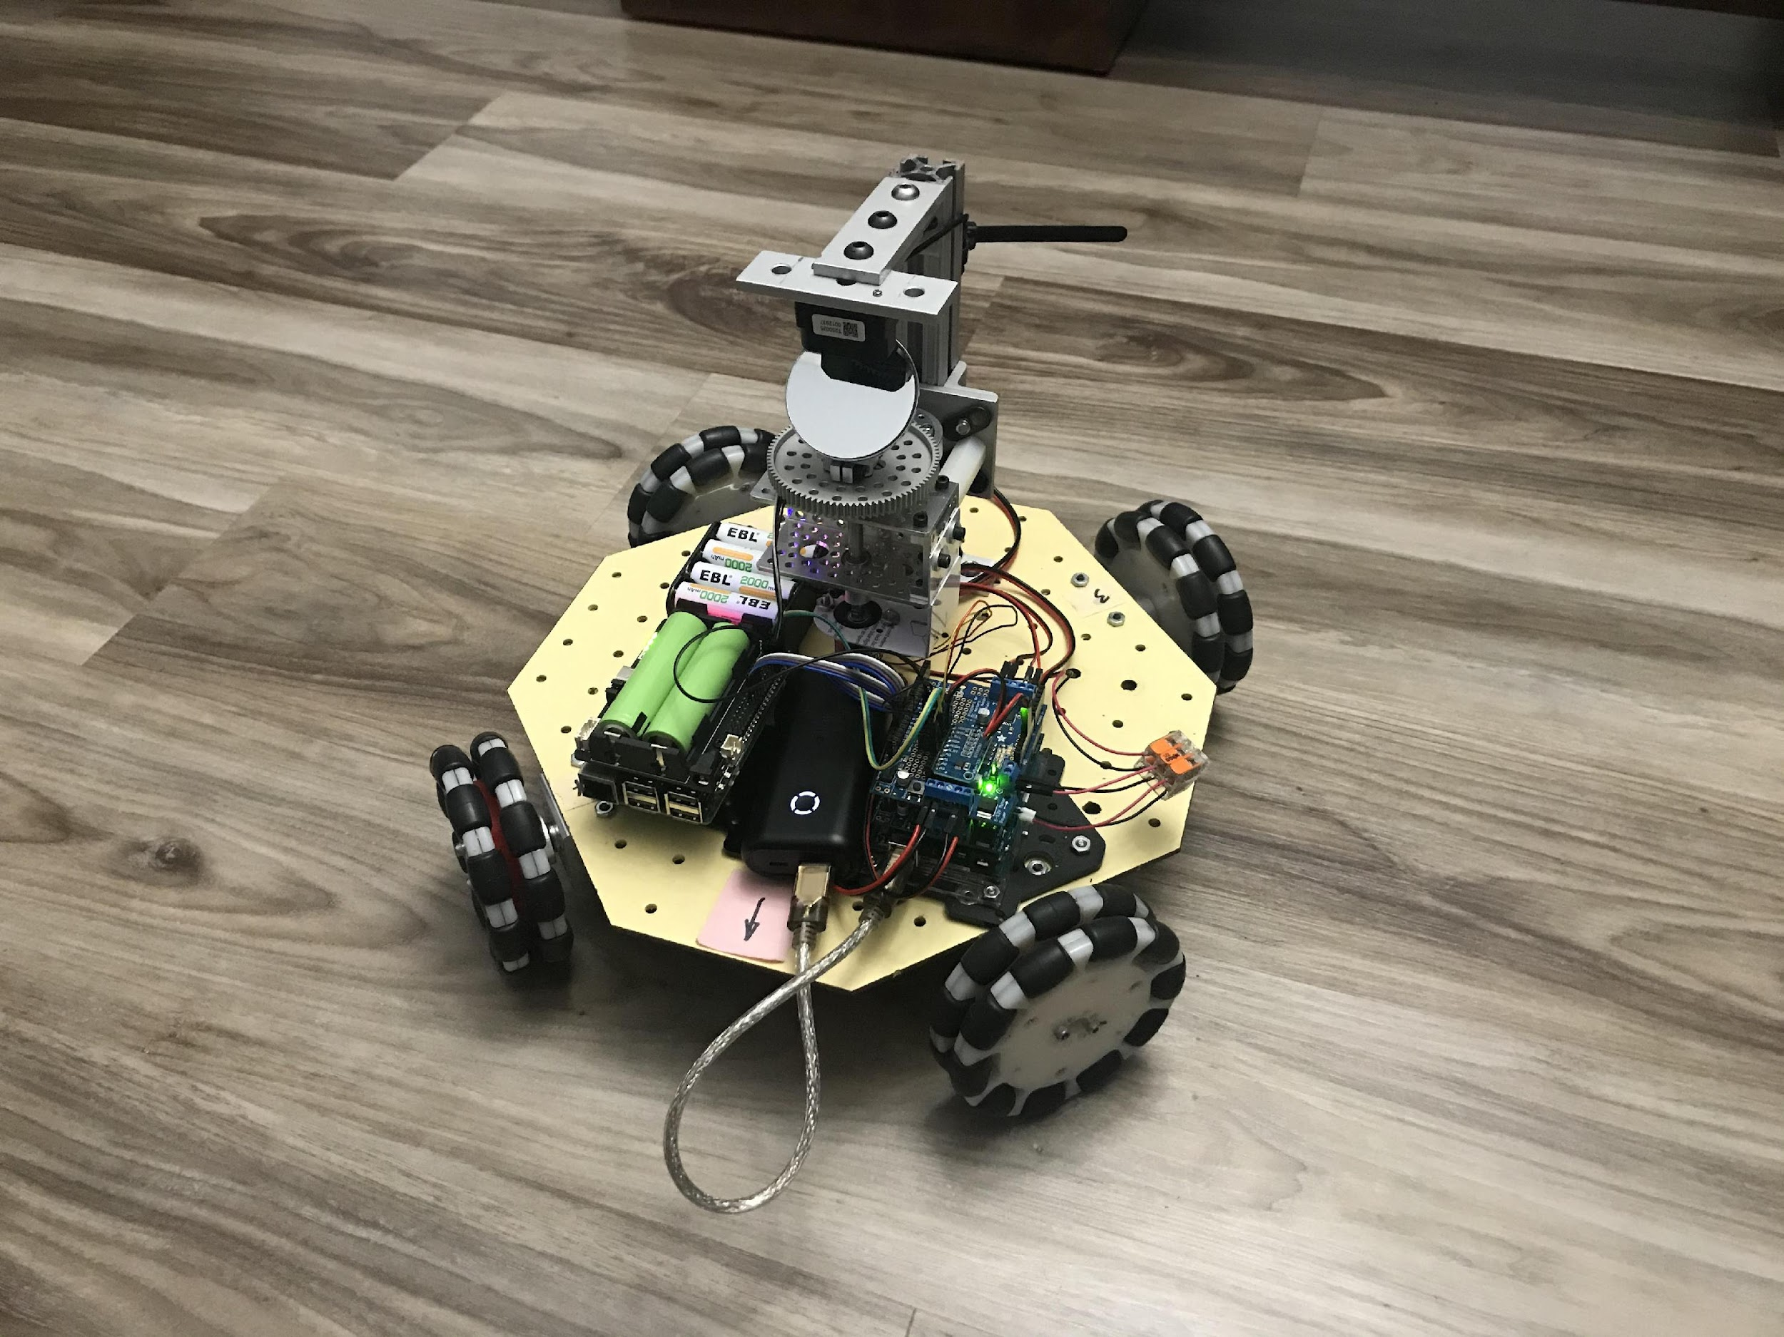
Holonomic robot w/ LiDAR and IMU
Omni-wheel robot
Notes:
13

Slide 14
ROS provides many needed functions
Can make a map of its environment
Localization (where am I on map?)
Sensor Fusion (odometer & IMU)
Path planning to goal pose
Obstacle Avoiding
Notes:
14

Slide 15
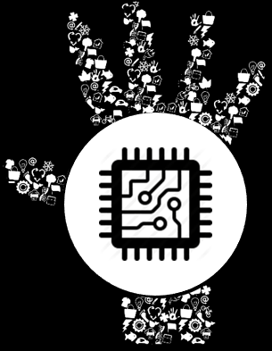

What Is ROS?
Notes:
15

Slide 16
What is ROS?
Not an OS, but a middle-ware
Currently runs best on linux (Ubuntu)
Defacto standard in robotics community
Handles communication between processes called “Nodes”
Nodes can be stopped/started on the fly
Nodes can run on different computers
Distribution of processing load
Collaboration between robots
Notes:
16

Slide 17
How ROS works
Roscore node is started first
Coordinates communication between nodes
Serves as master clock
Parameter server
Package manager
New nodes register with roscore
Specify topics they want to subscribe to
Specify topics they will publish
Notes:
17

Slide 18
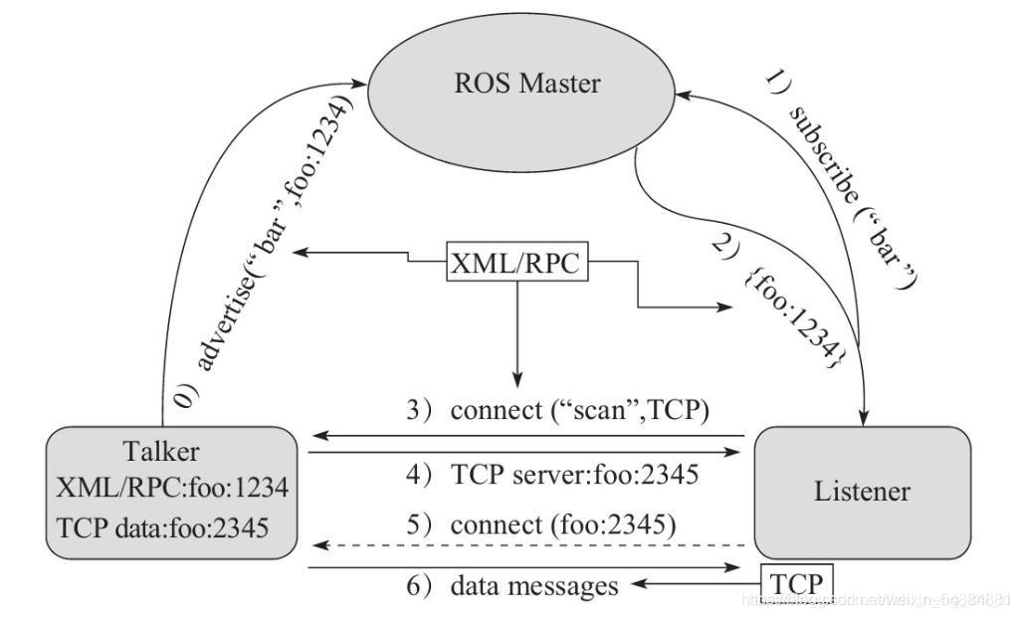
How ROS communication works
ROS communicates via TCP
Roscore is at ROS_MASTER_URI=http://raspi4:11311/
Notes:
18

Slide 19
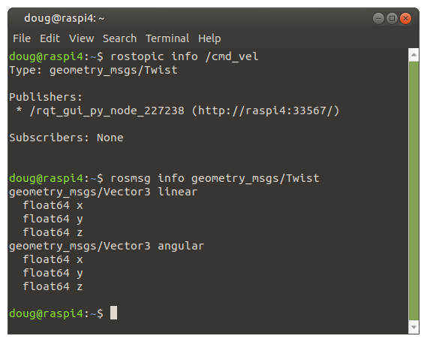
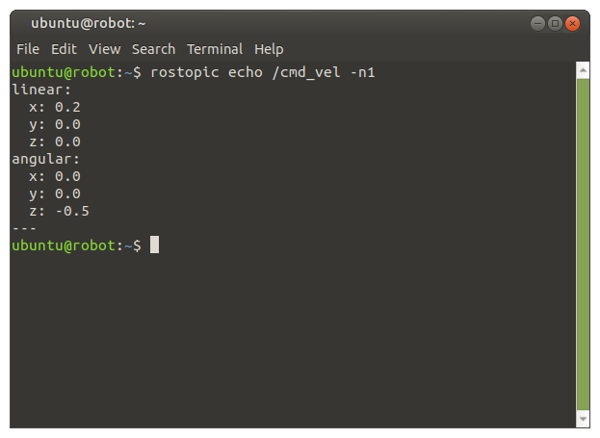
How ROS communication works
A Message is published over a channel called a Topic
Example: the /cmd_vel topic contains a Twist message
Notes:
19

Slide 20
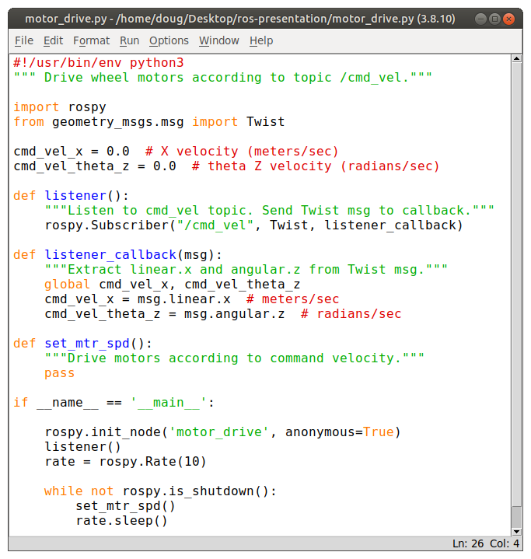
A Python program (node) to drive motors
Import rospy, Twist
Register w/ roscore
Subscribe to /cmd_vel
Listener()
Listener_callback()
Set loop rate to 10 Hz
Drive motors
Notes:
20

Slide 21
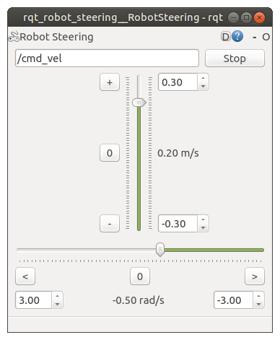
Robot Steering tool used to steer robot
Standard GUI tool
Command-line launched
User setable velocities
X (Linear)
Theta Z (Angular)
Publishes /cmd_vel @ 10 Hz
Notes:
21

Slide 22
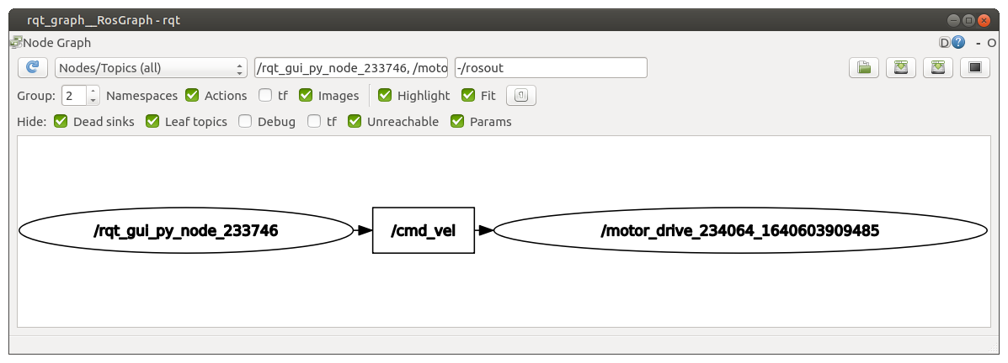
Use rqt_graph to explore nodes / topics
Notes:
22

Slide 23
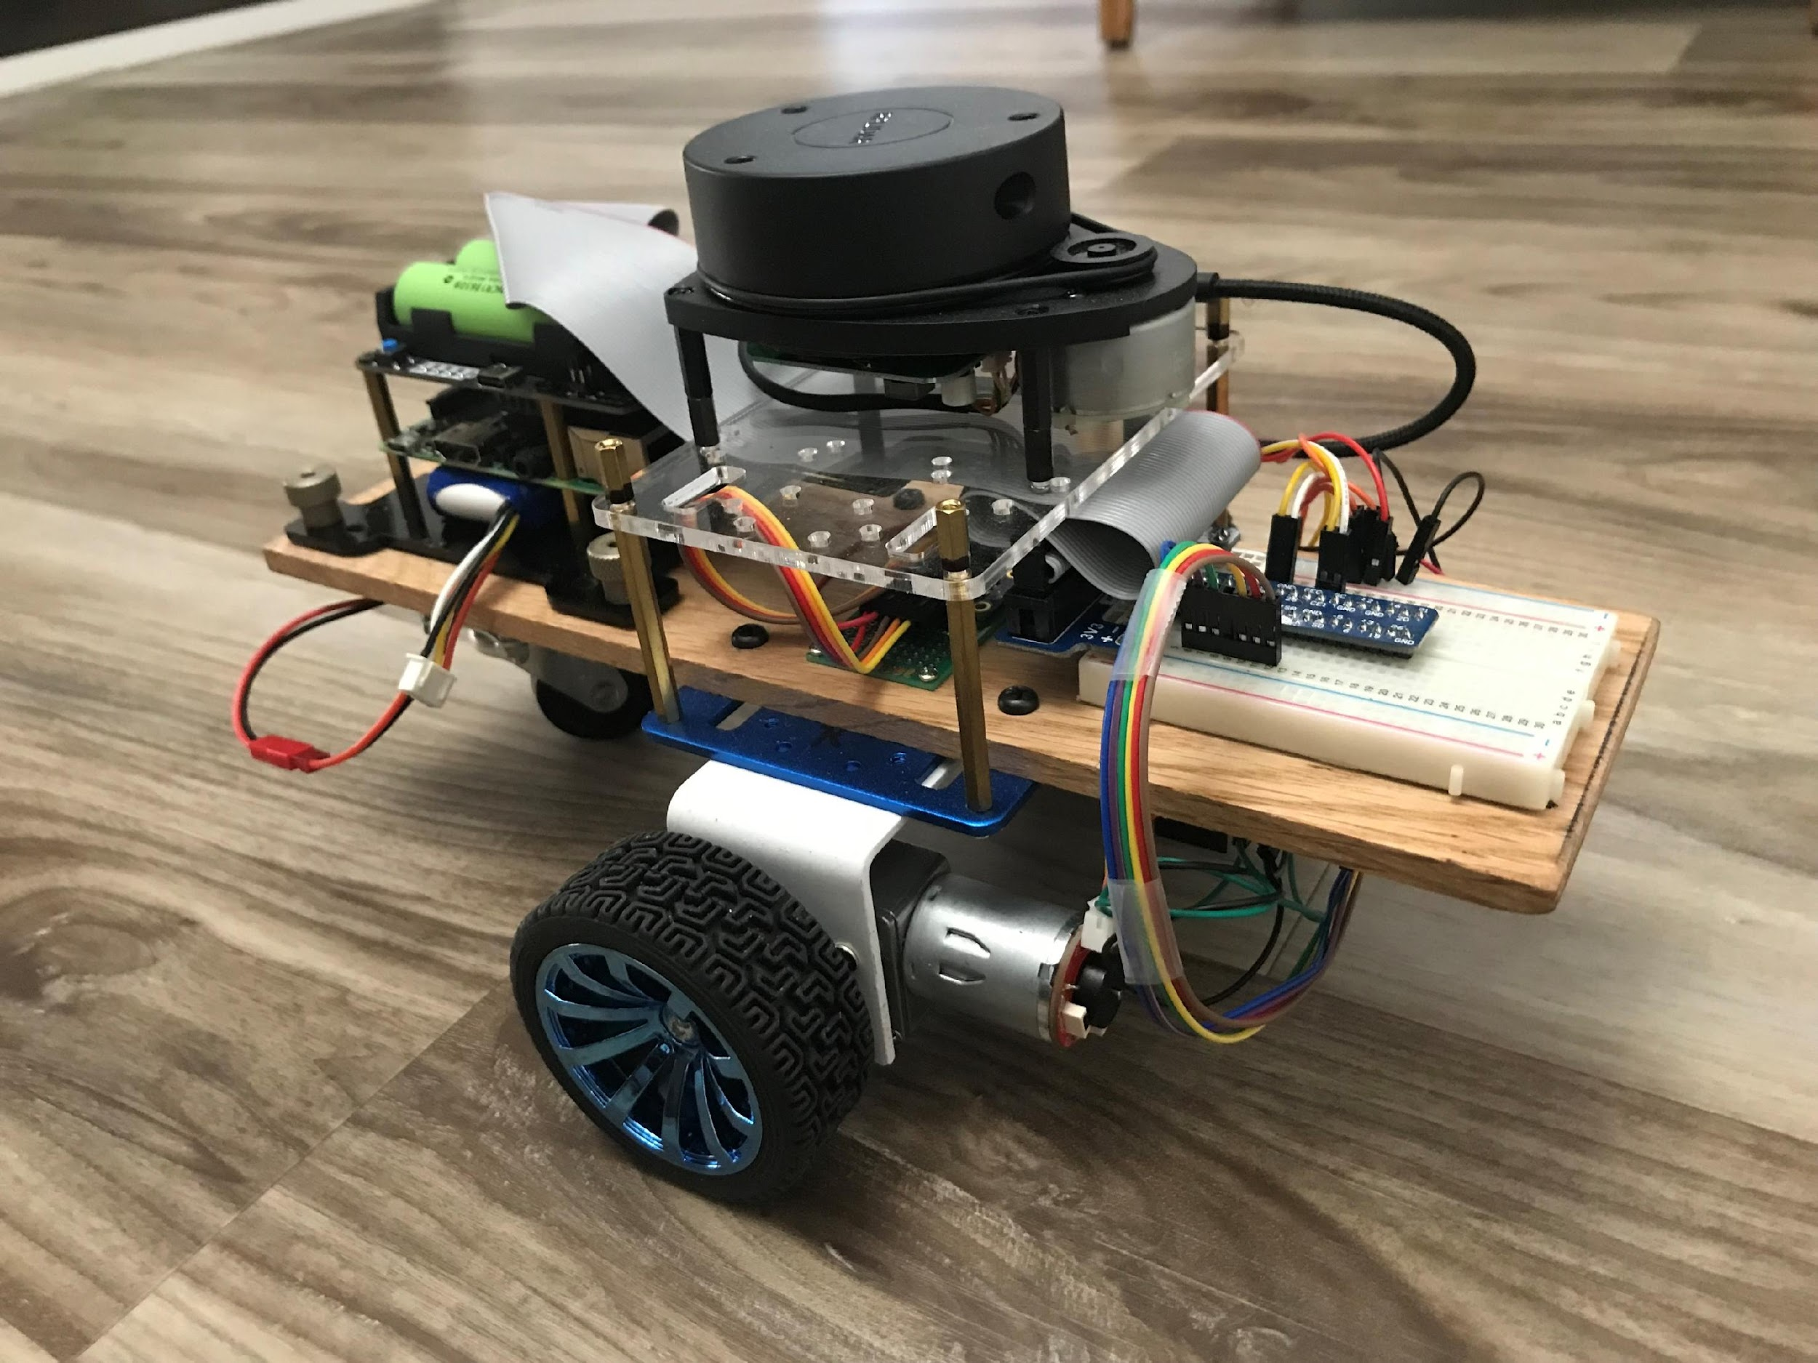
Let’s build a simple robot
Differential drive
Laser scan
IMU
Notes:
23

Slide 24
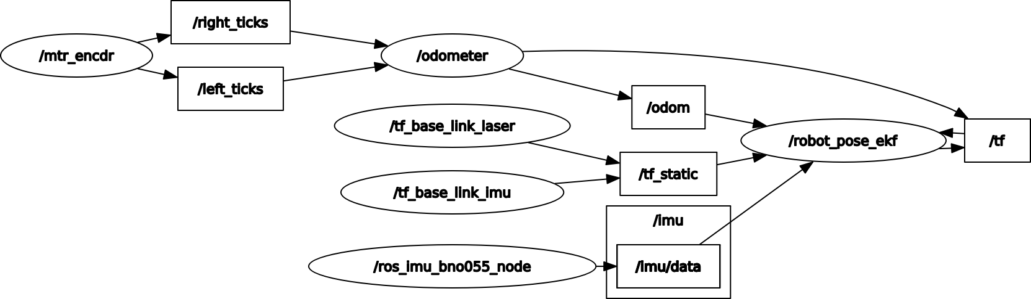
Node-Topic graph for our simple robot
Notes:
24

Slide 25
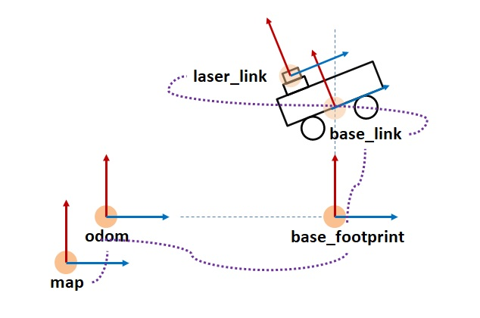
Coordinate Frames
Notes:
25

Slide 26
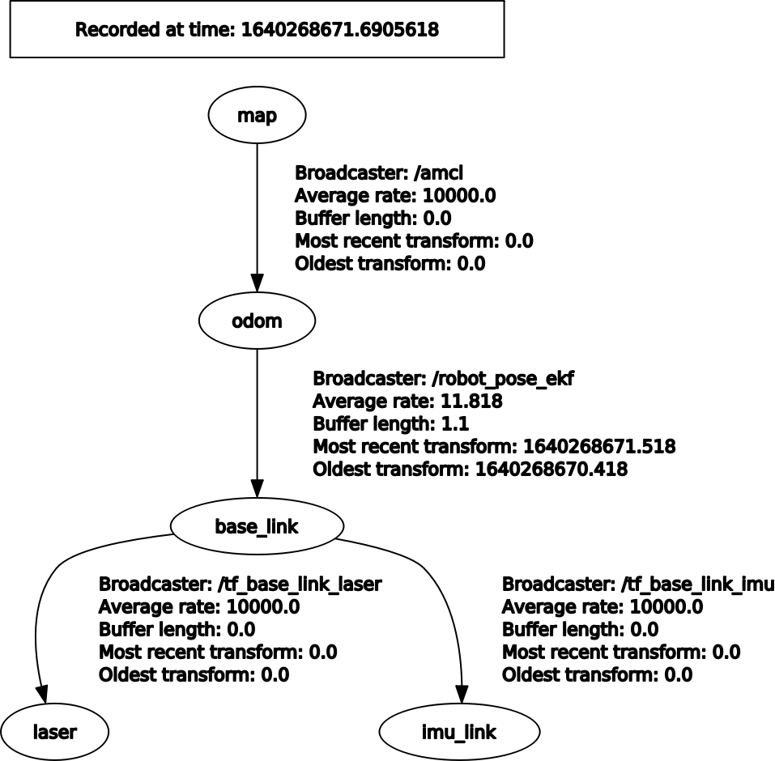
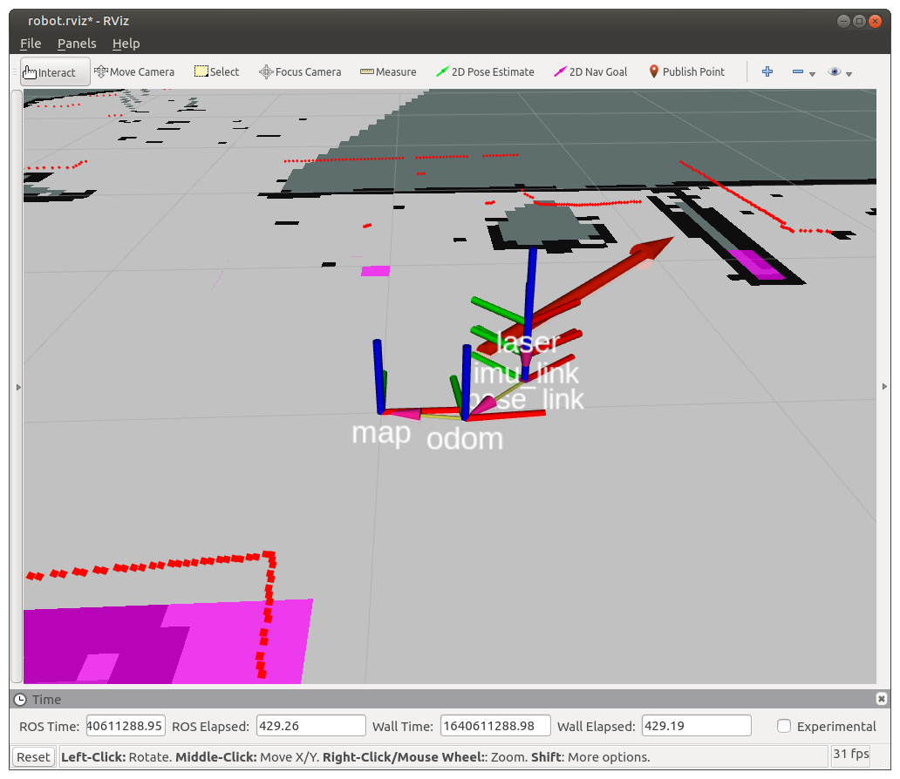
Coordinate Frames of our Robot
Notes:
26

Slide 27

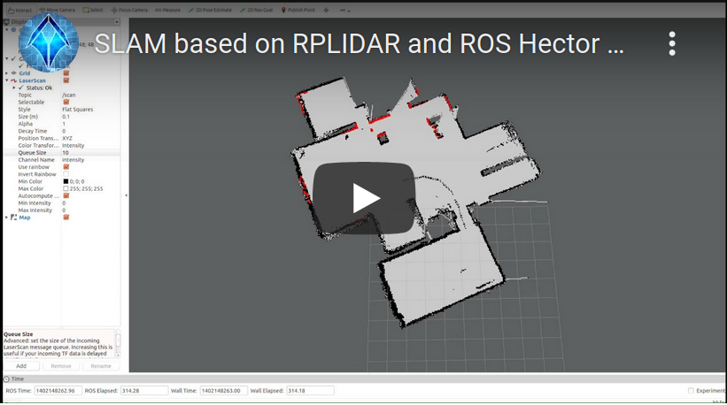
How the robot builds the map
Video:
https://youtu.be/pCF7P7u8pDk
Notes:
27
27

Slide 28
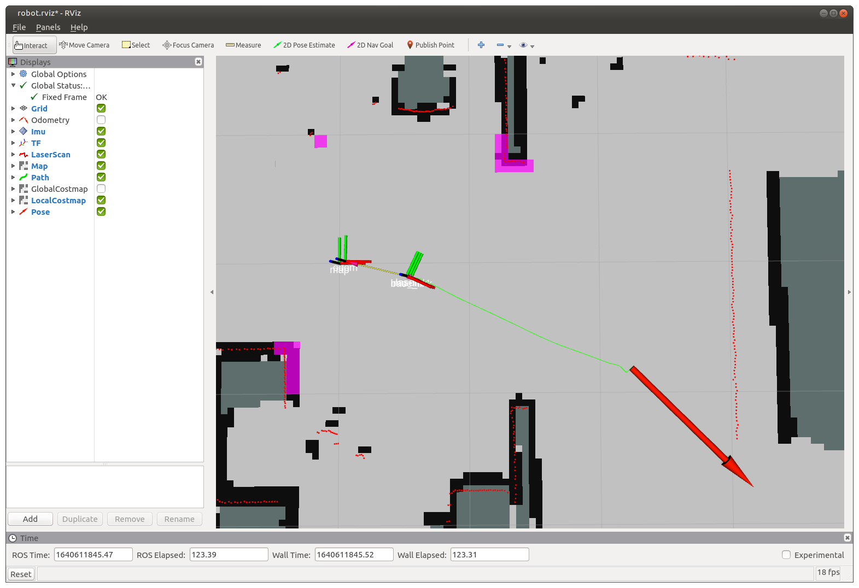
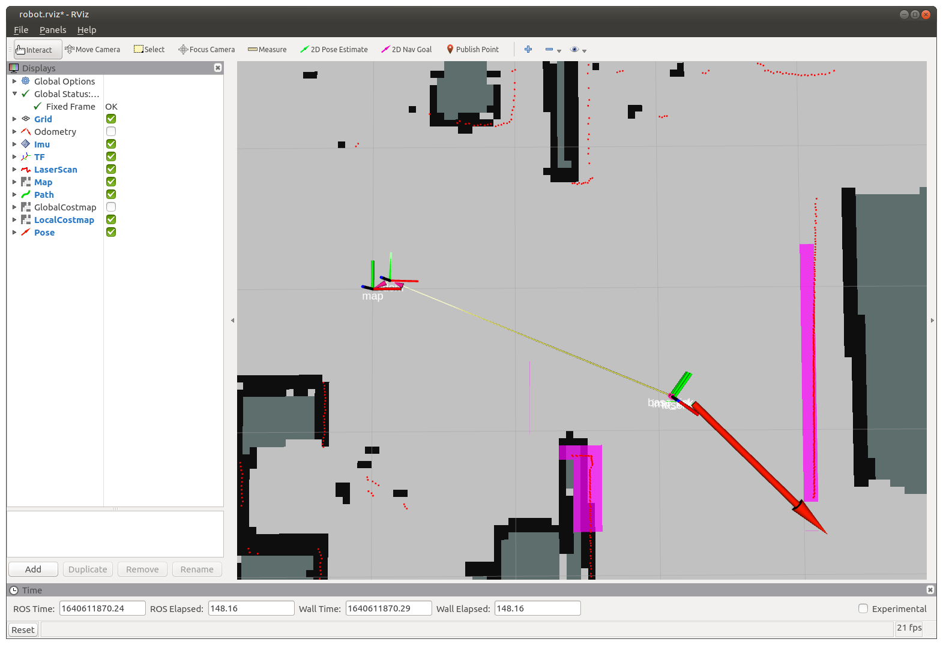
Path Planning
Notes:
28

Slide 29
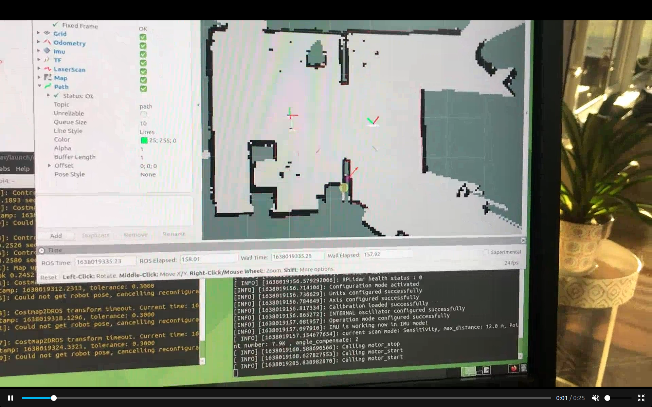
The robot drives to Goal Pose
Video:
https://user-images.githubusercontent.com/53412304/148745637-946173ff-d5c7-4747-9fac-c8e4dd46d131.mp4
Notes:
29
29

Slide 30
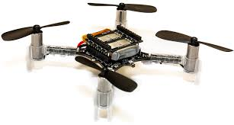
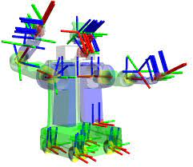
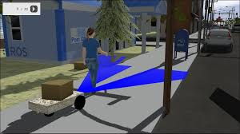
Other things ROS does...
Drones
Articulated Robots
Simulation
Notes:
30

Slide 31
How to Learn ROS
Online tutorials at wiki.ros.org/tutorials
Automatic Addison online tutorials
Book: Practical Robotics in C++ by Lloyd Brombach
Robot Ignite Academy
Digital Book: ROS_Robot_Programming_EN.pdf
Notes:
31

